Slide 1

STATISTICAL GUIDE TO STOCK MARKET

Slide 2
Objectives
How mathematical models are useful in prediction of stock prices
To understand the dip in stock prices due to some rumors or case studies.
Which statistical *coefficients or tools are useful to choose a particular share.

Slide 3
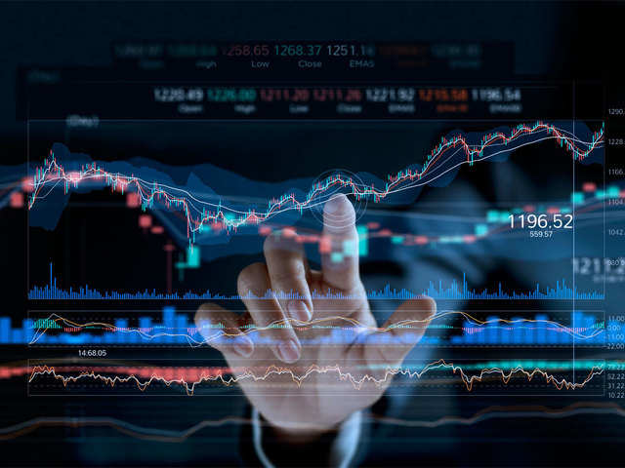
What is stock market ?
Stock of a corporation is all of the shares into which ownership of the corporation is divided.
In American English, the shares are collectively known as "stock".
A single share of the stock represents fractional ownership of the corporation in proportion to the total number of shares

Slide 4

Definitions-

Slide 5




Definitions
STOCK -Stock of a corporation is all of the shares into which ownership of the corporation is divided. In American English, the shares are collectively known as "stock". A single share of the stock represents fractional ownership of the corporation in proportion to the total number of shares
INDEX-The statistical aggregate that measures change, such as market performance or price movement is the index. Based on specific market characteristics, market indices calculate or measure the value of a portfolio of holdings, and investors use the market indices to compare performance, and use them as the basis for managing their investment portfolio
DIVIDEND-A stock dividend can be described as an increase in the number of shares of a company; the new shares are given to existing shareholders. These shares are paid on a pro-rata basis to the existing shareholders.

Slide 6
Other Definitions-
NIFTY 50 –The National Stock Exchange Fifty (Nifty) is the stock market index of the National Stock Exchange (NSE). Also known as NIFTY 50 and CNX Nifty, it comprises 50 stocks that are actively traded on NSE and is owned and managed by India Index Services and Products Ltd. (IISL), a subsidiary of NSE. Furthermore, the base value of the index is 1000, and it is computed using the free-float market capitalization weighted method.
SENSEX- Sensex is the stock market index of the Bombay Stock Exchange (BSE). With a base value of 100, Sensex is the market-weighted stock index which includes shares from the top, well-established 30 companies, based on their performance and financial soundness. Furthermore, Sensex is calculated by using the free-float market capitalization method, and the performance of the 30 selected stocks is directly reflected by the level of the index. Sensex is calculated by first determining the market capitalization of each of the 30 companies, and then multiplying it to the free-float factor, which provides the free-float market capitalization. It is then divided by the Index Divisor.
SEBI - Securities and Exchange Board of India (SEBI) is a statutory regulatory body entrusted with the responsibility to regulate the Indian capital markets. It monitors and regulates the securities market and protects the interests of the investors by enforcing certain rules and regulations.

Slide 7
Other Definitions-
BOMBAY STOCK EXCHANGE - Established in 1875 as the Native Share and Stockbrokers' Association, the Bombay Stock Exchange (BSE) is Asia's first exchange and the largest securities market in India.
The BSE has been instrumental in developing India's capital markets by providing an efficient platform for the Indian corporate sector to raise investment capital.
The BSE is known for its electronic trading system that provides fast and efficient trade execution.
The BSE enables investors to trade in equities, currencies, debt instruments, derivatives, and mutual funds.
The BSE also provides other important capital market trading services such as risk management, clearing, settlement.
NATIONAL STOCK EXCHANGE - The National Stock Exchange of India Limited (NSE) is India's largest financial market and the fourth largest market by trading volume.
The National Stock Exchange of India Limited was the first exchange in India to provide modern, fully automated electronic trading.
The NSE is the largest private wide-area network in India.
The NSE has been a pioneer in Indian financial markets, being the first electronic limit order book to trade derivatives

Slide 8
Other Definitions-
NEW YORK STOCK EXCHANGE - The New York Stock Exchange (NYSE), which dates back to 1792, is the largest stock exchange in the world based on the total market capitalization of its listed securities.﻿
Many of the oldest publicly traded U.S. companies are listed on the Big Board, the nickname for the NYSE.
NASADAQ- Nasdaq is a global electronic marketplace for buying and selling securities. Nasdaq was created by the National Association of Securities Dealers (NASD) to enable investors to trade securities on a computerized, speedy and transparent system.

Slide 9

HOW DOES A STOCK MARKET FUNCTION ?

Slide 10
FUNCTIONING -
The main function of a stock exchange is to facilitate the transactions associated with both buying and selling of securities. Buyers and sellers of shares and stocks can track the price changes of securities from the stock markets (derivatives, equity etc.) in which they operate.
Also, stock exchanges have multiple roles in an economy which make it vital. These roles include:
With the help of stockbrokers, the buyers and sellers participating in a stock market carry out their transactions. The brokers representing selling parties take their orders to the stock exchange floor and then find brokers representing parties willing to invest in similar stocks. If both parties agree to trade at the fixed price, the transaction takes place.
The concept behind how the stock market works is pretty simple. Operating much like an auction house, the stock market enables buyers and sellers to negotiate prices and make trades. ... Investors can then buy and sell these stocks among themselves, and the exchange tracks the supply and demand of each listed stock.

Slide 11
Some Statistical Tools Which Help Us To Pick a Stock From Stock Market
Price of a stock – The market price per share of stock .
Volume – It is the number of shares traded in a security or an entire market during a given period of time.
Dividend Policy – It is defined as the payment made by a company to its share holders.
Market Cap - It refers to the total market value of a company’s outstanding share.
Volatility – It is the statistical measure of the depression of returns for a given security or market index.
Earnings per share (EPS) -It is the portion of a company’s profit allocated to each share of common stock.
Cash flow per share - It is the after-tax earnings plus depreciation on a per-share basis that functions as a measure of a firm’s financial strength.
P/E Ratio - Price to earnings ratio is the ratio for valuing a company that measures its current share price relative to its per-share earnings.( Market value per share / Earning per share )
Share Holding ratio - The shareholder equity ratio shows how much of the company’s assets are funded by equity shares.

Slide 12
More Tools
The Price to Sales Ratio (PSR) shows the value of each dollar the stock market places on the value of the company’s revenue. It takes the total market capitalization divided by the year’s sales. A low number shows that a stock’s price may be undervalued as compared to its competition, and conversely, a high number shows that it is overvalued as compared to its competitors.
Price to Book Ratio or Price to Equity Ratio(P/B) - The Price to Book Ratio helps determine whether the company is undervalued or overvalued as compared to the rest of the companies listed on the exchange. It shows what the company is worth if it were to be broken up and sold today.
Face Value - Face value is a financial term used to describe the nominal or dollar value of a security, as stated by its issuer. For stocks, the face value is the original cost of the stock, as listed on the certificate.
Beta Value- Beta is a numeric value that measures the fluctuations of a stock to changes in the overall stock market.
Standard Deviation - Standard deviation helps determine market volatility or the spread of asset prices from their average price. When prices move wildly, standard deviation is high, meaning an investment will be risky. Low standard deviation means prices are calm, so investments come with low risk.

Slide 13
How statistical tools help us in analyzing a stock
EPS is earnings per share. A higher EPS indicates a greater value because the investor will pay more for a company’s share if they think that the company has higher profits in comparison to its share price.
Put call ratio (PCR): When PCR is greater than 1, it means put volume>call volume; it means the trend of the stock is bearish. If PCR is less than 1, put volume<call volume; indicating a bullish market.
Price to Book value ratio: Lower price to book value ratio indicates that it is a better value, and the stock is undervalued; indicating a potential of increase in the stock in the future.
Notes:
Difference between stocks and shares.

Slide 14

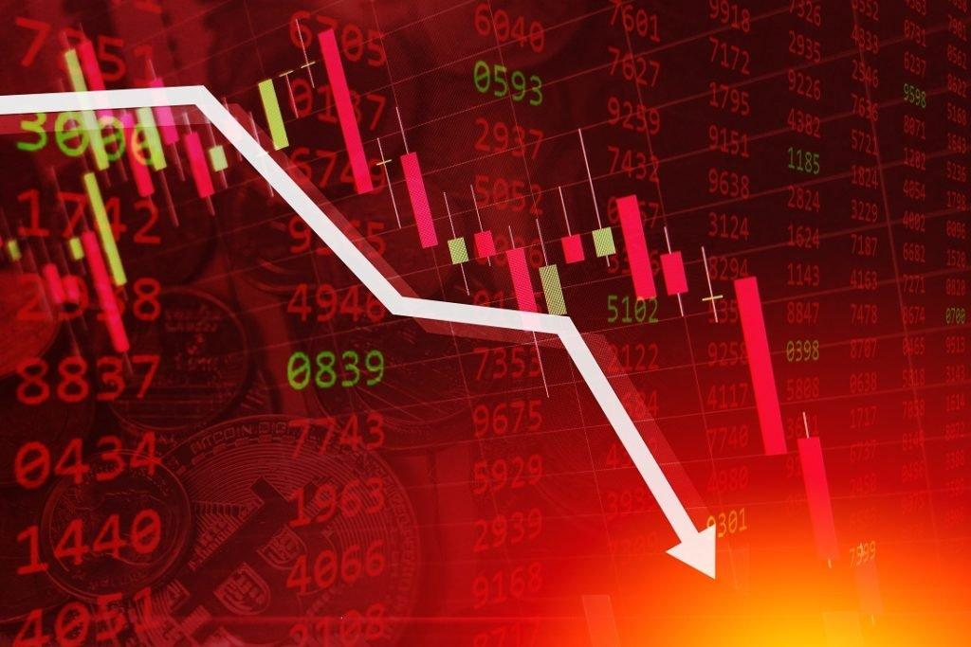
How is standard deviation used in determining risks
Risk measurement is a very big component of many sectors of the finance industry. While it plays a role in economics and accounting, the impact of accurate or faulty risk measurement is most clearly illustrated in the investment sector. Knowing the probability that a security—whether you invest in stocks, options, or mutual funds—moves in an unexpected way can be the difference between a well-placed trade and bankruptcy. Traders and analysts use several metrics to assess the volatility and relative risk of potential investments, but the most common metric is standard deviation.
What Is Standard Deviation?
Standard deviation is a basic mathematical concept that measures volatility in the market, or the average amount by which individual data points differ from the mean. Simply put, standard deviation helps determine the spread of asset prices from their average price
Standard deviation helps determine market volatility or the spread of asset prices from their average price. When prices move wildly, standard deviation is high, meaning an investment will be risky. Low standard deviation means prices are calm, so investments come with low risk. It shows the dispersion of returns from the mean return value

Slide 15
BETA VALUE
Beta measures a stock's volatility, it is a numeric value that measures the fluctuations of a stock to changes in the overall stock market.
A stock that swings more than the market over time has a beta above 1.0.
If a stock moves less than the market, the stock's beta is less than 1.0
High-beta stocks are supposed to be riskier but provide higher return potential; low-beta stocks pose less risk but also lower returns.

Slide 16
How does beta value help in analyzing a stock ?
We chose a particular sector i.e. Banking sector .
In banking sector we chose the stocks SBI and HDFC, further analyzed them.

Slide 17
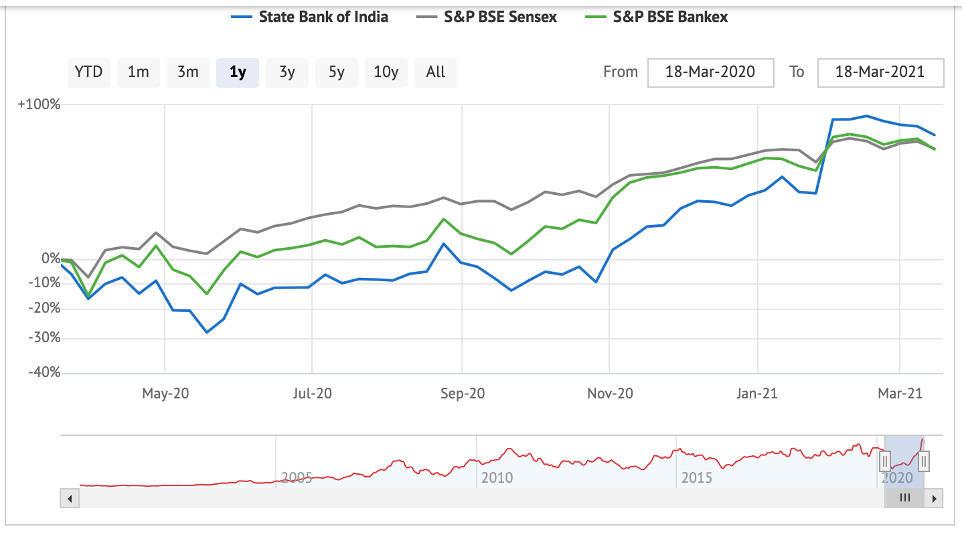
SBI BANK
In this graph, the green line represents the sector benchmark or the sector trend , the blue line represents the trend of the stock and black line is the Sensex trend line. We can see that the beta value of SBI bank is 1.12 where 1 represents that the stock is swinging above the sector trend line and 12 represents that the stock is 12% volatile i.e., it is following the sector trends as seen in the market. Thus, SBI bank is a safe stock to invest in.

Slide 18
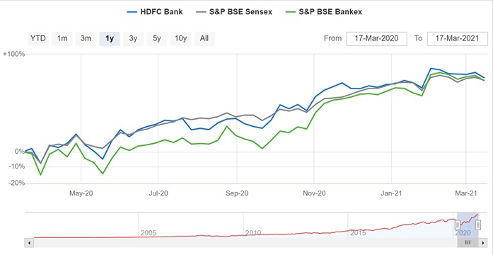
HDFC BANK
In this graph, the green line represents the sector benchmark or the sector trend , the blue line represents the trend of the stock and the black line represents the Sensex trend line We can see that the beta value of HDFC bank is 1.15 where 1 represents that the stock is swinging above the market trend line and 15 represents that the stock is 15% volatile i.e., it is following the market trends as seen in the graph. Thus, HDFC bank is a less risky stock to invest in.

Slide 19
HOW TO HANDPICK STOCKS FROM A PARTICULAR SECTOR ? & WHICH SECTOR TO GO FOR PUBLIC OR PRIVATE ?

Slide 20
PROCEDURE
We selected top 3 sectors of the market which are – Banking , Automobile and Pharma .
Further , we selected one company from the public and one company from the private sector for each of the selected sector.
We did the box cox transformation using Qi Macros on excel to make our sample follow normal distribution

Slide 21
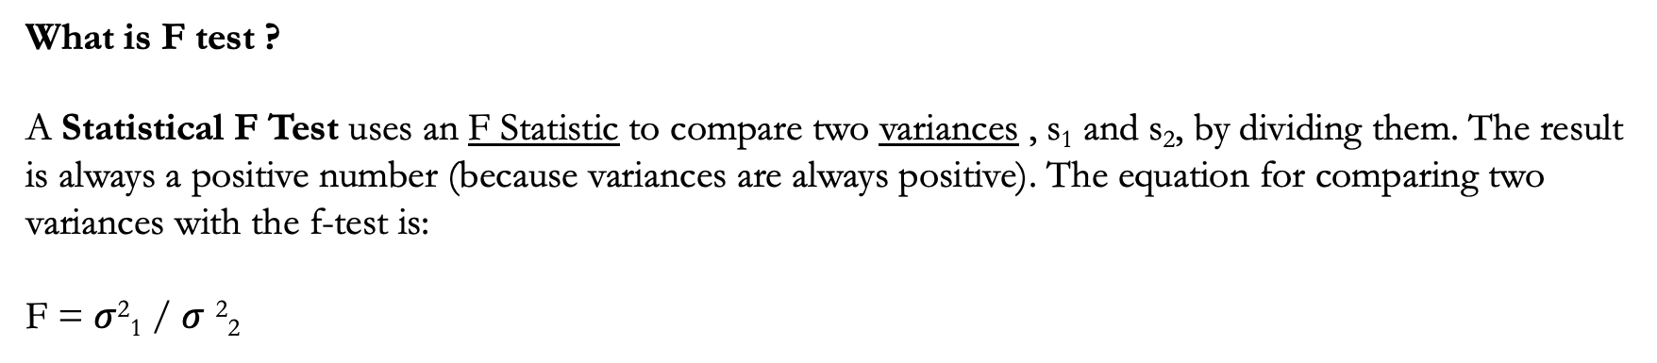
F test to Compare Variances

Slide 22

BANKING SECTOR
Public sector – State Bank of India
Private sector – HDFC Bank

Slide 23
Variance of Sbi Bank( Public) – 135.266 ( Variance 1 )
Variance of HDFC Bank(Private) – 695.361774 ( Variance 2 )
H0: Variance of both SBI Bank and HDFC Bank are same .
H01:Variance of both SBI Bank and HDFC Bank are different.
N=30
Degree of Freedom = N-1= 29
F calculated value - Variance 1 / Variance 2 = 5.1406
F table value = 1.08
Conclusion : Since , F calculated > F tabulated . We reject H0
Variance 2 > Variance 1 , thus HDFC is a riskier stock to invest in and SBI bank is less risky .
Thus, for risk lovers HDFC would be a great choice and for risk averse SBI would be a great choice.

Slide 24
SBI BANK VS HDFC BANK
As shown in the graphs we can see that SBI has a beta value of 1.12 i.e it is 12% volatile thus safer than HDFC which has a beta value of 1.15 ( 15% volatile ).

Slide 25

AUTOMOBILE SECTOR
Private sector – MAHINDRA
Private sector – TATA MOTORS

Slide 26
41.08361
Variance of Tata Motors– 6699.449 ( Variance 1 )
Variance of Mahindra – 485.9071 (Variance 2)
N = 30
H0: Variance of both Tata Motors and Mahindra are same .
H1:Variance of both Tata Motors and Mahindra are different.
Degree of Freedom (N-1) = 29
F calculated value - Variance 1 / Variance 2 =13.7875
F tabulated Value = 1.80
Conclusion : Since , F calculated > F tabulated . We reject H0
Variance 1 > Variance 2 , thus Tata Motors is a riskier stock to invest in and Mahindra is less risky .
Thus, for risk lovers Tata Motors would be a great choice and for risk averse Mahindra would be a great choice.

Slide 27
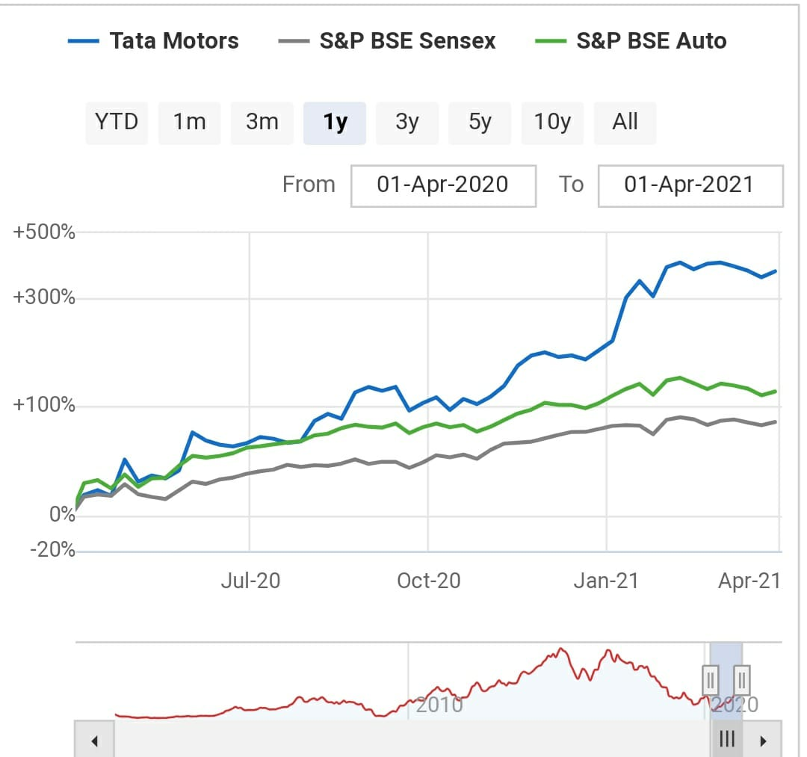
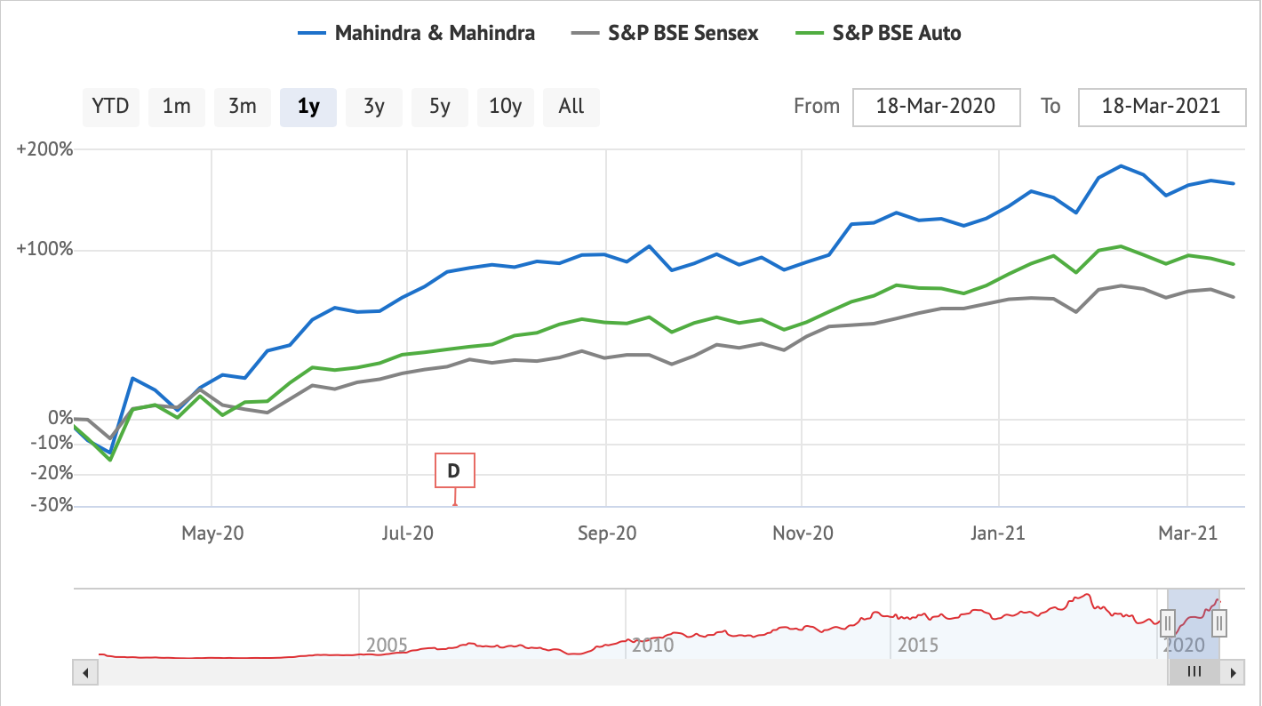
TATA MOTORS VS MAHINDRA
As shown in the graphs we can see that Tata Motors has a beta value of 1.39 i.e. it is 39% volatile thus riskier than Mahindra which has a beta value of 1.08 ( 8% volatile ).

Slide 28

PHARMA SECTOR
Private sector – ZOTA & SUN PHARMA

Slide 29
Variance of Sun Pharma – 566.1178 ( Variance 1 )
Variance of Zota – 169.087 (Variance 2)
H0: Variance of both Sun Pharma and Zota are same .
H1:Variance of Sun Pharma and Zota are different.
N= 30
Degree of Freedom = N-1 = 29
F calculated value - Variance 1 / Variance 2 = 3.34
F table value – 1.08
Conclusion : Conclusion : Since , F calculated > F tabulated . We reject H0
Variance 2 <Variance 1 , thus Sun Pharma is a riskier stock to invest in and Zota is less risky .
Thus for risk lovers Sun Pharma would be a great choice and for risk averse Zota would be a great choice.

Slide 30
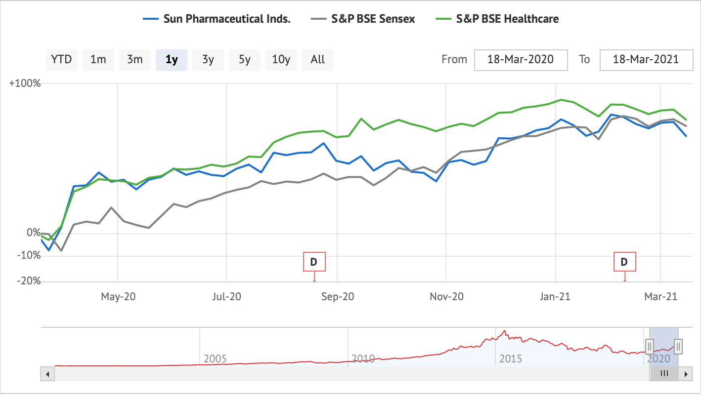
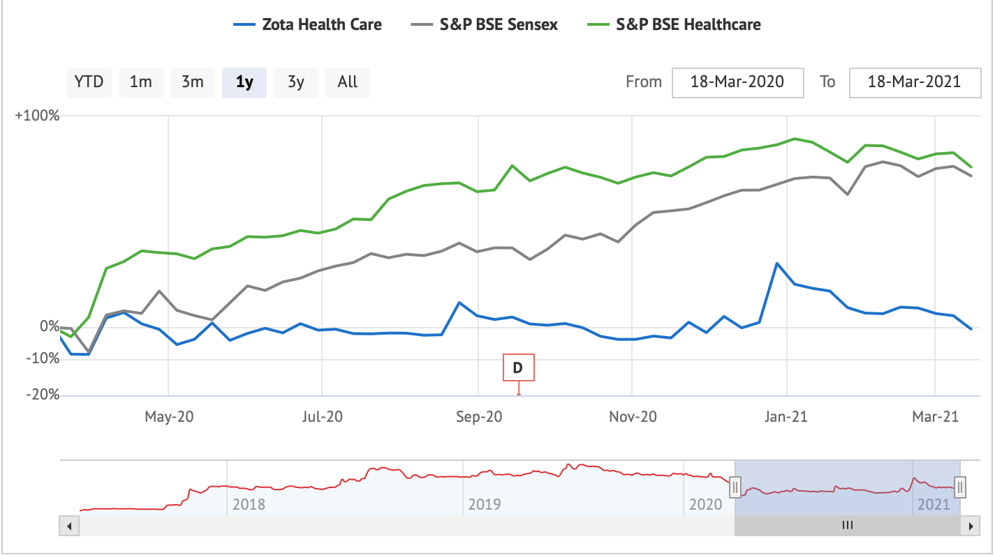
SUN PHARMA VS ZOTA
As shown in the graphs we can see that Sun Pharma has a beta value of 0.60 i.e. it is 60 % volatile thus riskier but has good returns whereas Zota which has a beta value of 0.40 ( 40% volatile ) is not a safe stock to invest in due to very low returns as seen in the graph.

Slide 31
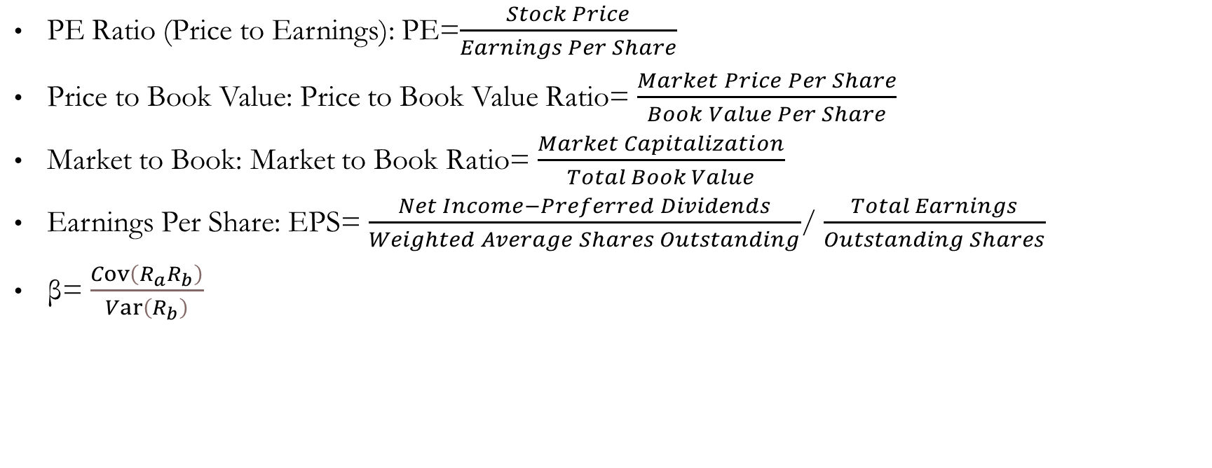
Important formulae

Slide 32
MATHEMATICAL MODELS

Slide 33
BLACK SCHOLES MODEL
What Is the Black Scholes Model?
The Black Scholes model, also known as the Black-Scholes-Merton (BSM) model, is a mathematical model for pricing an options contract. It assumes these instruments (such as stocks or futures) will have a lognormal distribution of prices.
The Basics of the Black Scholes Model
The model assumes the price of heavily traded assets follows a geometric Brownian motion with constant drift and volatility.
Also called Black-Scholes-Merton, it was the first widely used model for option pricing. It's used to calculate the theoretical value of options using current stock prices, expected dividends, the option's strike price, expected interest rates, time to expiration and expected volatility

Slide 34
ASSUMPTIONS:
The Black-Scholes model makes certain assumptions:
The option is European and can only be exercised at expiration.
No dividends are paid out during the life of the option.
Markets are efficient (i.e., market movements cannot be predicted).
There are no transaction costs in buying the option.
The risk-free rate and volatility of the underlying are known and constant.
The returns on the underlying asset are normally distributed.
While the original Black-Scholes model didn't consider the effects of dividends paid during the life of the option, the model is frequently adapted to account for dividends by determining the ex-dividend date value of the underlying stock.

Slide 35
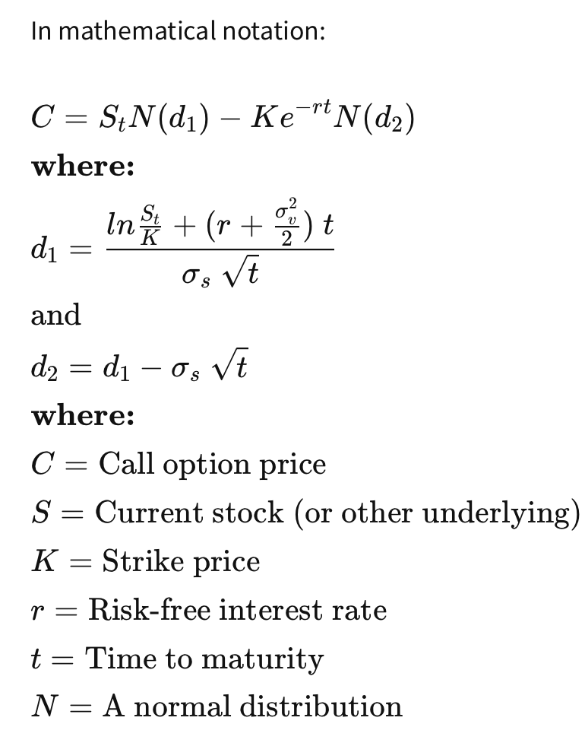
The Black Scholes Formula
The mathematics involved in the formula are complicated and can be intimidating. Fortunately, you don't need to know or even understand the math to use Black-Scholes modelling in your own strategies.

Slide 36
PREDICTIVE MODELS

Slide 37
Prediction of Stock Market using Market Sentiment
Market sentiment refers to the overall attitude of investors toward a particular security or financial market. It is the feeling or tone of a market, or its crowd psychology, as revealed through the activity and price movement of the securities traded in that market. In broad terms, rising prices indicate bullish market sentiment, while falling prices indicate bearish market sentiment.
Technical indicators can help investors measure market sentiment.
Understanding Market Sentiment
Market sentiment, also called "investor sentiment," is not always based on fundamentals. Day traders and technical analysts rely on market sentiment, as it influences the technical indicators they utilize to measure and profit from short-term price movements often caused by investor attitudes toward a security

Slide 38
The VIX﻿: The VIX, also known as the fear index, is driven by option prices. A rising VIX means an increased need for insurance in the market. If traders feel the need to protect against risk, it's a sign of increasing volatility.
The High-Low Index: The high-low index compares the number of stocks making 52-week highs to the number of stocks making 52-week lows.
Bullish Percent Index: The bullish percent index (BPI) measures the number of stocks with bullish patterns based on point and figure charts.
Moving Averages: Investors typically use the 50-day simple moving average (SMA) and 200-day SMA when determining a market’s sentiment.
Stock Market Prediction: The efficient-market hypothesis suggests that stock prices reflect all currently available information and any price changes that are not based on newly revealed information thus are inherently unpredictable

Slide 39
Random walk and efficient market hypotheses
The efficient market hypothesis posits that stock prices are a function of information and rational expectations, and that newly revealed information about a company's prospects is almost immediately reflected in the current stock price. This would imply that all publicly known information about a company, which obviously includes its price history, would already be reflected in the current price of the stock.
Accordingly, changes in the stock price reflect release of new information, changes in the market generally, or random movements around the value that reflects the existing information set. Burton Malkiel, in his influential 1973 work A Random Walk Down Wall Street, claimed that stock prices could therefore not be accurately predicted by looking at price history.
As a result, Malkiel argued, stock prices are best described by a statistical process called a "random walk" meaning each day's deviations from the central value are random and unpredictable. This led Malkiel to conclude that paying financial services persons to predict the market hurt, rather than helped, net portfolio return.
Several empirical tests support the notion that the theory applies generally, as most portfolios managed by professional stock predictors do not outperform the market average return after accounting for the managers' fees.

Slide 40
CASE STUDIES

Slide 41
ICICI BANK
“Investors happy after Chanda Kochhar quits”
ICICI Bank shares jump by 6% Chanda Kochhar has quit ICICI Bank after controversy; Lender revealed it has accepted her request to seek early retirement.
The performance of ICICI Bank was quite interesting as investors joy knew no bounds and this was reflected in the share price of the lender. This came after its MD & CEO Chanda Kochhar resigned from her leadership position. ICICI Bank jumped by nearly 6% with an intraday high of Rs. 320.90 per piece. The shocking part of it all is the fact that on this day, Sensex plunged as much as 800 points! At around 1500 hours, the bank was trading at Rs. 313.50 per piece up by 3.26% on BSE.
ICICI Bank revealed it has accepted the request of Chanda Kochhar to seek early retirement from the Bank and that too as early as possible. Kochhar will also relinquish office from the Board of Directors of the Bank's subsidiaries.

Slide 42
NESTLE
“Nestlé India’s stock performance shows the Maggi crisis is far behind”
The Maggi ban had resulted in a 17% year-on-year drop in the annual revenues in 2015 to ₹8,175 crore.
To be sure, Nestlé India fared relatively well in the recently concluded June quarter clocking 11% year-on-year growth.
The Chinese use two brush strokes to write the word ‘crises. One brush stroke stands for danger; the other for opportunity. In a crisis, be aware of the danger—but recognize the opportunity," John F. Kennedy had said.
Nestlé India Ltd appears to have taken inspiration from that rather earnestly in recent years.
After all, its shares have doubled since the Maggi noodles ban in 2015, suggesting the company navigated the crisis well
.In fact, after the ban on Maggi noodles sales in June 2015, the company’s stock had settled at ₹5,828 by the end of December 2015. Since then, the stock has risen at a compound annual growth rate ( CAGR) of as much as 24%.
The Maggi ban had resulted in a 17% year-on-year drop in the annual revenues in 2015 to ₹8,175 crore. Nestlé India follows a January to December fiscal year. For perspective: If one annualizes revenues for the half-year ended 30 June 2019, the company is set to earn revenue worth about ₹12,000 crore for 2019. This represents an average annual growth of 10%.

Slide 43
SIGNAL
When Tesla CEO Elon Musk urged his Twitter followers to "use Signal," he meant the encrypted messaging app. Some people appear to have taken it the wrong way.
Shares of an obscure and unrelated company called Signal Advance, which trades over the counter, surged 527% and 91% on two consecutive days , climbing from 60 cents to $7.19.
Signal Advance is so small that it doesn't report financials with the SEC. As of March 2019, it had no full-time employees other than CEO Chris Hymel, who did not immediately respond to a request for comment.
Because of the swarm of unintended investor interest, the company now has a market cap of $660 million, up from $55 million. The stock had traded under $1 since 2015.

Slide 44
CONCLUSION
Stock market is not only dependent on statistical or market indices , it is also dependent on the sentiments of investors. Rumors gives us an tentative idea of how the stock is going to move with respect to the market but statistical tools help us back those decisions with logics.
Private companies are more riskier to invest in than public companies( since the std deviation is more) but on the other hand private companies give us more returns.
It is believed that few incidents tend to move according to the rumors but as shown in our project there are many case studies which had outcomes totally opposite to what was being expected.

Slide 45
Bibliography
https://www.investopedia.com/ask/answers/021915/how-standard-deviation-used-determine-risk.asp
https://www.alphagamma.eu/finance/3-ways-use-statistics-invest-stocks/

Slide 46
ACKNOWLEDGEMENT
We’ve taken immense amount of efforts in this project. But it’d not have been possible without the guidance and constant support of our professor and mentor, Mr Hemant Sir.
We’re highly indebted to you for your supervision as well as providing us necessary information regarding the project. You’ve been patient and helped us figure out the next steps after completion of a task.
Sir, we’d like to extend our sincere gratification to you.

Slide 47




THE TEAM
Aashvi Shah
75252019023
Gargi Rajadnya
75252019019
Vineeta Khanna
75252019010
NOTE: This is the copyright slide of the team

Slide 48
Thank You !

